Slide 1
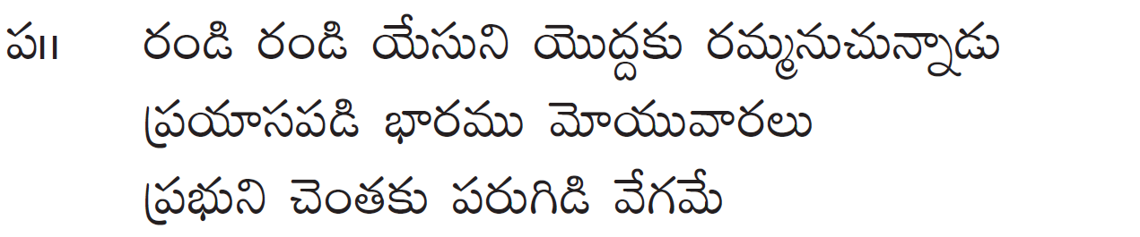
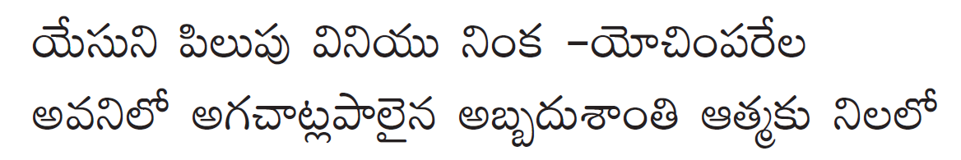
Randi Randi Yesuni Yoddaku

Slide 2
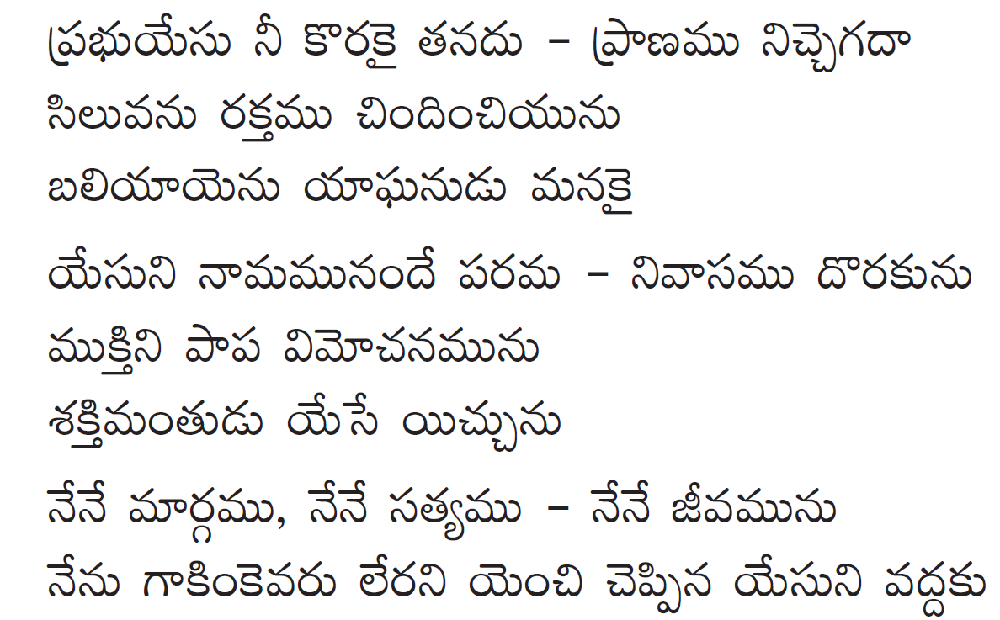
Randi Randi Yesuni Yoddaku

